Slide 1
Laboratory work 9 The morphological structure of the flower

Slide 2
Flowering Plants
The flowering plants, or angiosperms (also called Angiospermae, Magnoliophyta, or Anthophyta), are a monophyletic group currently thought to be the sister group to the gymnosperms. Angiosperms are by far the most numerous, diverse, and “successful” existing plant group, containing well over 95% of all land plant species alive today.
Actually, flowering plants grow in every habitable region and are dominant in some aquatic and most terrestrial ecosystems, the notable exception to the latter being coniferous forests.
Angiosperms comprise the great bulk of our economically important plants, including our most valuable food crops.

Slide 3
FLOWER
Perhaps the most obvious distinguishing feature of angiosperms is the flower. A flower can be defined as a modified, determinate shoot system bearing one or more stamens, collectively called the androecium, and/or one or more carpels (making up one or more pistils), collectively called the gynoecium.
Most angiosperm flowers are bisexual (perfect), containing both stamens and carpels, but some are unisexual (imperfect), having only stamens or carpels.
In addition, most (but not all) flowers have a perianth, consisting of modified leaves at the base of the shoot system.

Slide 5
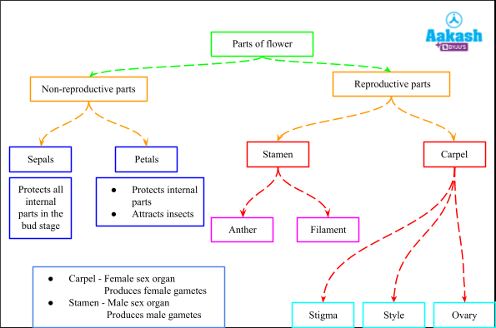

Slide 6
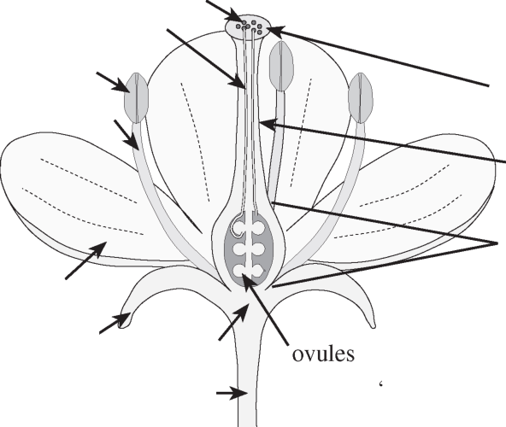
pollen
pollen tubes
stamen (of androecium)
anther
stigma
filament
pistil
^{style}
(of gynoecium)
ovary
petal
(Pistil may consist of one or more carpels)
(of corolla)
perianth
sepal (of calyx)
receptacle
pedicel
(Perianth units termed “tepals” or perianth segments” if similar)
Fig- A typical (diagrammatic) flower, illustrating the parts.

Slide 7
Introduction
A Floral Formula is a very useful “short-hand” method of recording floral structure. The four whorls of the flower are represented by capital letters: K = calyx or sepals, C = corolla or petal (T = perianth, if K and C are indistinguishable), A = androecium or stamens and G = gynoecium or pistil. A number is placed after and slightly below each of these letters to indicate the number of parts in each whorl. If the parts of any whorl are fused, wholly or partially, the figure is enclosed in brackets.

Slide 8
PERIANTH = CALYX + COROLLA
SEPALS small and green, collectively called the CALYX, formula: K
PETALS often large and showy, collectively called the COROLLA, formula: C
TEPALS used when sepals and petals are not distinguishable, they form SIMPLE PERIANTH, formula: P
ANDROECIUM collective term for stamens: formula: A
STAMEN = FILAMENT + ANTHER
ANTHER structure containing pollen grains
FILAMENT structure connecting anther to receptacle

Slide 9
Ovary position is a useful feature in classification. An ovary attached above other floral parts is termed superior; when it lies below the attachment of other floral parts, it is inferior.
If the flower is regular or actinomorphic (i.e. has several planes of symmetry) the formula is prefixed with the sign * ; if irregular or zygomorphic (i.e. has only one plane of symmetry) the formula is prefixed by ↑ . Bisexual flowers have the ♂ and ♀ signs combined.

Slide 10
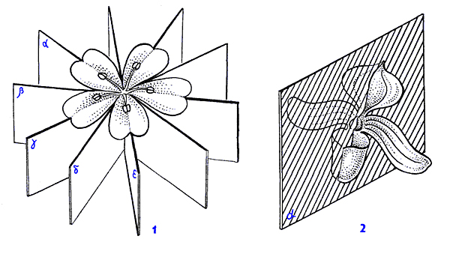

Slide 11
Flower formula
The following signs are used to enrich formulas:
PLUS “+” is used to show different whorls; minus “–” shows variation; “_” = “or”
BRACKETS “[]” and “()” show fusion
COMMA “,” shows inequality of flower parts in one whorl
MULTIPLICATION “” shows splitting
INFINITY “1” shows indefinite number of more than 12 parts

Slide 12
Most important parts of the flower

Slide 13
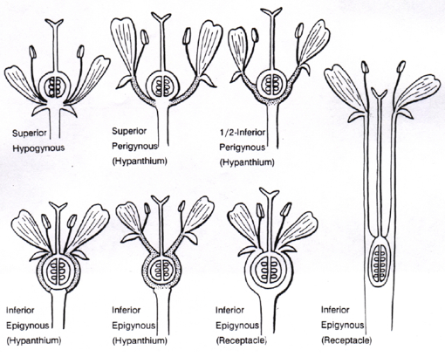
Ovary position

Slide 14
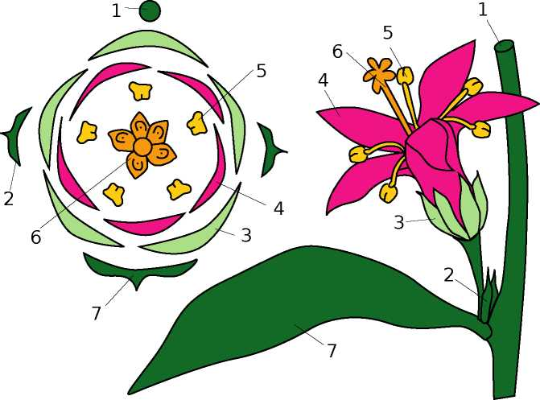
Flower diagram is a graphical way of flower description. This diagram is a kind of cross-section of the flower. Frequently, the structure of pistil is not shown on the diagram. Also, diagrams sometimes contain signs for the description of main stem (axis) and flower-related leaf (bract). The best way to show how to draw diagram is also graphical (Fig.1); formula of the flower shown there is
Fig. 1 - How to draw a diagram (graphical explanation): compare numbers on plant and on diagram.

Slide 15
Traditionally, the flowering plants have been divided into two major groups, or classes,: the Dicots (Magnoliopsida) and the Monocots (Liliopsida).
The table summarizes the major morphological differences between monocots and dicots.
MONOCOTS | DICOTS
Embryo with single cotyledon | Embryo with two cotyledons
Pollen with single furrow or pore | Pollen with three furrows or pores
Flower parts in multiples of three | Flower parts in multiples of four or five
Major leaf veins parallel | Major leaf veins reticulated
Stem vacular bundles scattered | Stem vascular bundles in a ring
Roots are adventitious | Roots develop from radicle
Secondary growth absent | Secondary growth often present

Slide 18
Pollination
The stamens and pistils are directly involved with the production of seed. The stamen bears microsporangia (spore cases) in which are developed numerous microspores (potential pollen grains); the pistil bears ovules, each enclosing an egg cell.
When a microspore germinates, it is known as a pollen grain. When the pollen sacs in a stamen’s anther are ripe, the anther releases them and the pollen is shed. Fertilization can occur only if the pollen grains are transferred from the anther to the stigma of a pistil, a process known as pollination.

Slide 19
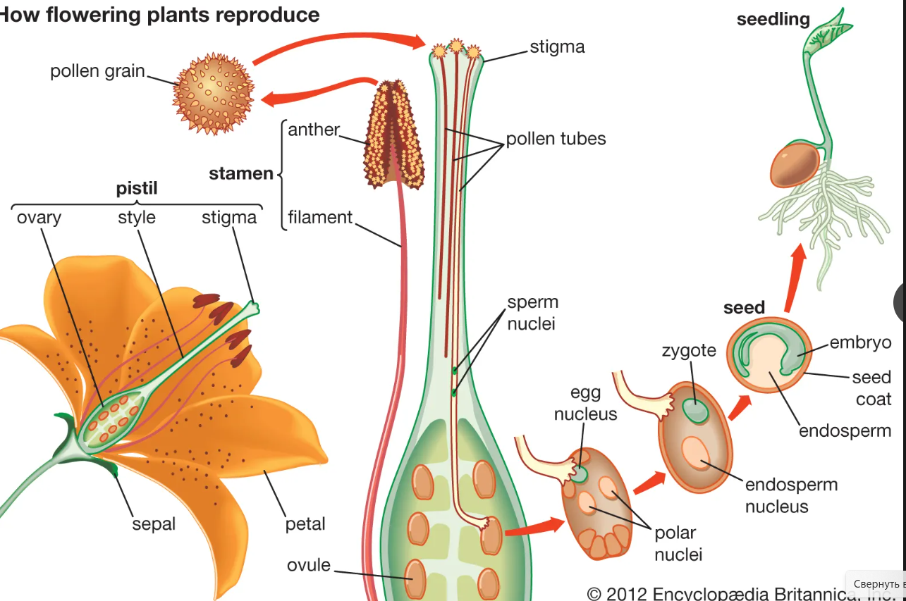

Slide 20
There are two chief kinds of pollination:
(1) self-pollination, the pollination of a stigma by pollen from the same flower or another flower on the same plant;
(2) cross-pollination, the transfer of pollen from the anther of a flower of one plant to the stigma of the flower of another plant of the same species.

Slide 21
After a pollen grain has reached the stigma, it germinates, and a pollen tube protrudes from it. This tube, containing two male gametes (sperms), extends into the ovary and reaches the ovule, discharging its gametes so that one fertilizes the egg cell, which becomes an embryo, and the other joins with two polar nuclei to form the endosperm. (Normally many pollen grains fall on a stigma; they all may germinate, but only one pollen tube enters any one ovule.) Following fertilization, the embryo is on its way to becoming a seed, and at this time the ovary itself enlarges to form the fruit.

Slide 22
Double fertilization
The male gametophyte (pollen grain) is produced in the anther of the stamen. The gynoecium is the female reproductive part composed of carpels or pistils. The female gametophyte (embryo sac) is produced in the ovule enclosed by the ovary.
Before fertilization, the female and male gametes have been produced in the gametophytes (although male gametes are sometimes produced after the pollen grain reaches a flower pistil).

Slide 23
The ovary of a flower contains one or more ovules, which in turn contain the embryo sac. Remember that the embryo sac (haploid female gametophyte) is composed of eight nuclei and seven cells that have specific locations:
Three cells stay near the micropyle, one being the egg cell (female gamete). The other two, called synergid cells, seats one on each side of the egg and are thought to attract the pollen tube.
Other three cells, called the antipodal cells, remain on the opposite side of the micropyle. Their function is unknown and they disintegrate near the time of fertilization.
The remaining two nuclei, called polar nuclei, stay at the center of the large cell. These also participate in the fertilization process.
A pollen grain (haploid male gametophyte) has two cells inside, a tube cell and a generative cell.

Slide 24
The process of double fertilization in flowering plants
Once the pollen grain is transferred from the anther to the stigma of a pistil, the pollen grain germinates, and the tube cell produces a pollen tube. The pollen tube is a long and slender tube that goes all the way down through the style and reaches the interior of the ovary. The generative cell moves through this tube while it divides once by mitosis, producing two haploid cells (two sperms).
Inside the ovary, the pollen tube gets to an ovule and enters through the micropyle (an opening in the integuments or layers that surrounds the embryo sac). The two sperm cells are discharged into the embryo sac. One sperm fertilizes the egg cell, producing a diploid zygote. The other sperm fuses with the two polar nuclei, resulting in a triploid cell. Hence, a double fertilization occurs in angiosperms.

Slide 25
The diploid zygote grows into an embryo, dividing through mitosis. The triploid cell forms the nutritious tissue of the seed, also dividing through mitosis, called the endosperm. Thus, after the double fertilization, the ovule develops into a seed that contains an embryo and the endosperm, surrounded by the integuments that become the seed coat. The ovary develops into a fruit that contains one or more seeds.

Slide 26
Material:
Class Magnoliopsida
Order Ranunculales
Family Ranunculaceae (buttercup family), representatives:
Genus Ranunculus, Ranunculus sp.
Genus Trollius, Trollius sp.,
Genus Delphinium, Delphinium sp.
Objective: To investigate the structural features of flowers of Ranunculus sp., Trollius sp. and Delphinium sp.

Slide 27
Tasks of work
Ranunculus: consider and draw the appearance of plant. Consider and draw the view of perianth from below side, longitudinal section of a flower, note on a cone-like receptacle and the location of the parts of a flower, fruit (aggregate achenes). Write a floral formula.
Delphinium: consider and draw the side view of flower, rear sepal with a spur, a stamen, fruit (follicles). Write a floral formula.

Slide 28
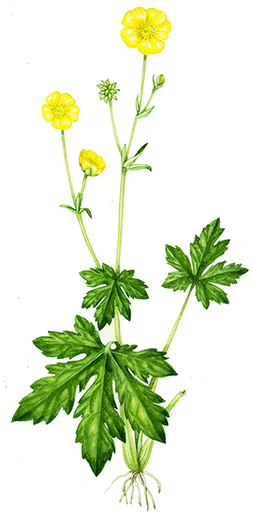
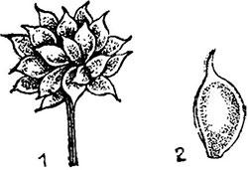
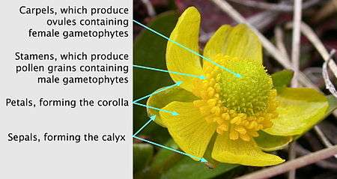
Ranunculus sp.
Floral formula and floral diagram of Ranunculus
1-Aggregate achenes, 2- achene
*K₅ C₅ A∞ G∞

Slide 29
Tasks of work
Trollius: consider and draw longitudinal section of flower, note convex receptacle, arrangement of sepals, staminodes, stamens and pistils.
Consider and draw petal-like sepal. Consider and draw stamen, pistil, fruit (aggregate follicles). Write a floral formula.
Trollius sp.
Stem: unbranched, glabrous.
Flower: Perianth spherical, yellow, 2–4 cm (0.8–0.16 in.) wide. Petals 5–15, small, inside calyx leaves. Petal-like sepals approx. 15, concave, yellow. Stamens many. Gynoecium separate, with many pistils. Flowers solitary or as 2–3-flower cymes.
Leaves: Alternate, basal leaves long-stalked, stem leaves short-stalked–stalkless. Basal leaf blades roundish, usually deeply 5-lobed, lobes pinnatifid–large-toothed. Stem leaf blades smaller and with narrower lobes.
Fruit: Dark brown, creased, keel-backed, sharp-pointed follicle. Several follicles together.

Slide 30
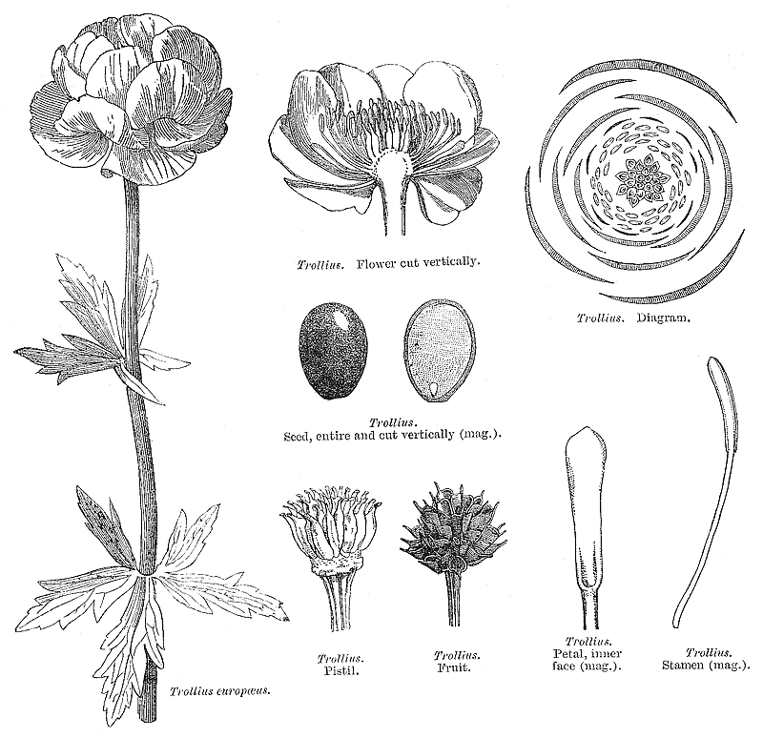
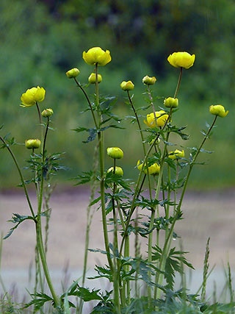
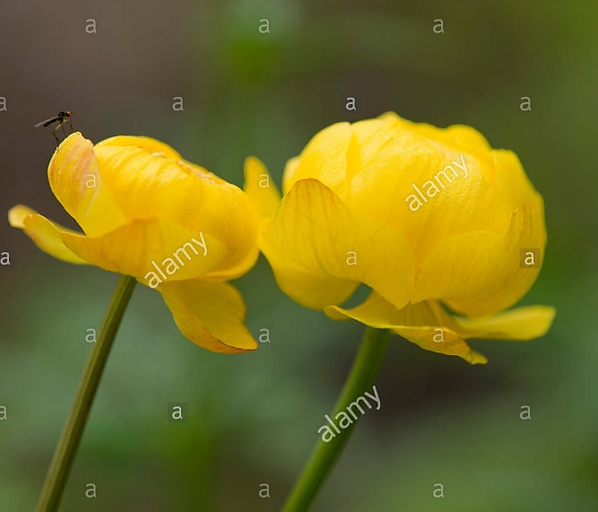
*
K5 C∞ A∞ G∞
Trollius sp.

Slide 31
Tasks of work
Delphinium sp.: consider and draw the side view of flower, rear sepal with a spur, a stamen, fruit (follicles). Write a floral formula.
Delphinium
The leaves are deeply lobed with three to seven toothed, pointed lobes in a palmate shape.
The main flowering stem is erect, and varies greatly in size between the species, from 10 centimetres in some alpine species, up to 2 m tall in the larger meadowland species.

Slide 32
Flower: Pedicellate, Bracteate, Bracteolate (two bracteoles), Bisexual, Complete, Zygomorphic, Hypogynous.
In summer the plant is topped with a raceme of many flowers, varying in color from purple and blue, to red, yellow, or white. In most species each flower consists of five petal-like sepals which grow together to form a hollow pocket with a spur at the end, which gives the plant its name, usually more or less dark blue. Within the sepals are four true petals, small, inconspicuous, and commonly colored similarly to the sepals. The eponymous long spur of the upper sepal encloses the nectar-containing spurs of the two upper petals.
Fruit: carpels indefinite, apocarpous, fruit an aggregate follicle.
The seeds are small and often shiny black. The plants flower from late spring to late summer, and are pollinated by butterflies and bumble bees.

Slide 33
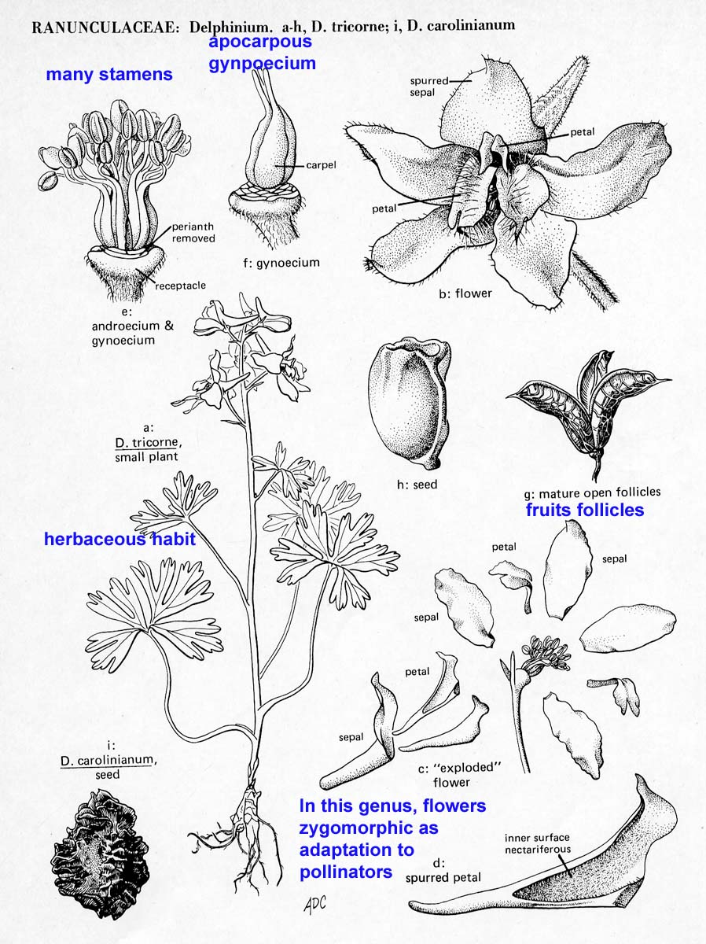
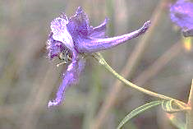
Floral Formula: ↑ K5 C5 A∞ G1
Delphinium sp.

Slide 34
Class Magnoliopsida Subclasses Rosidea Order Rosales Family Rosaceae Order Fabales Family Leguminosae (Fabaceae)

Slide 35
Family Rosaceae (Rose Family)
Subfamilies
In the subfamily Rosoideae many apocarpous pistils mature into achenes,
while in the Prunoideae a single monocarpellate pistil matures into a drupe.
In subfamily Spiraeoideae the gynoecium consists of two or more apocarpous pistils that mature into follicles. In all of these cases the ovary is superior and there is commonly some development of a perigynous zone.
However, in a fourth subfamily, Maloideae, the ovary is compound and inferior, and an epigynous zone may occur.

Slide 36
Material:
Class Magnoliopsida,
Subclasses Rosidea
Order Rosales
Family Rosaceae (rose family)
Subfamily Spiraeoideae, representatives:
Spiraea sp.
herbarium, wet material (inflorescences)
Objective:
To investigate the structural features of flowers of Spiraea.
Tasks of work:
Spiraea sp.: consider and draw longitudinal section of a flower, note the parts of flower, hypanthium, cyclic arrangement of stamens and staminodes, gynoecium. Write a floral formula.

Slide 37
Characters of Rosaceae:
Shrubs with prickles;
root -tap, branched sometimes adventitious arising from stem cuttings;
Stem - erect, prostrate or climber, branched, hard and woody, runner or sucker.
leaves simple or compound, pinnate, alternate, stipulate;
Inflorescence:
Solitary (Potentilla, Rosa servica) or grouped in racemose (Agrimonia). terminal corymbose (Rosa moschata), terminal cyme (Geum) or corymbose cyme (Potentilla sibbaldi).
flowers actinomorphic very rarely zygomorphic hypo-, peri- or epigynous;
calyx gamosepalous (a flower with a calyx made up of fused sepals is referred to as a gamosepalous flower.), 5; petals 5, polypetalous;
stamens indefinite; carpels 1 to many, apo (having distinct carpels that are not joined together.)- or syncarpous (carpels of the gynoecium are united in a compound ovary), situated on swollen receptacle;
fruit a collection of achenes, drupe or pome.

Slide 39
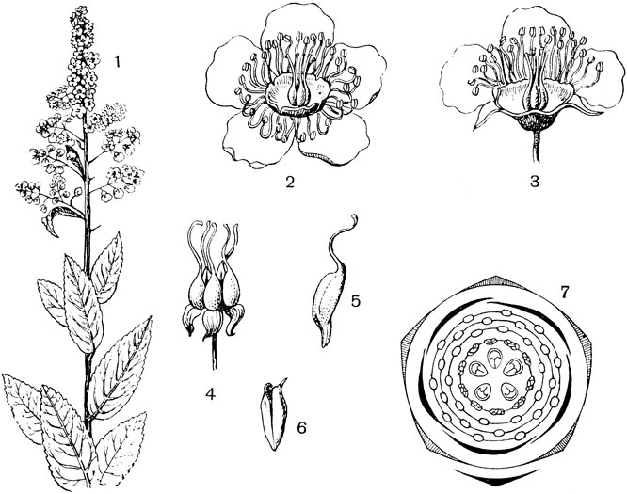
Spiraea salicifolia: 1 - appearance; 2 - a flower; 3 - flower in section; 4 - gynoecium; 5 - one of the pistils; 6 - fruit; 7 - floral diagram
* K5 C5 A10+10+10 G5
Floral Formula
Spiraea sp.

Slide 40
Material:
Class Magnoliopsida,
Subclasses Rosidea Order Rosales
Family Rosaceae (rose family)
Subfamily Prunoideae, representatives:
Prunus sp
Objective:
To investigate the structural features of flowers of Prunus.
Tasks of work
Prunus sp.: consider and draw longitudinal section of flower, note hypanthium, arrangement of sepals, petals, stamens.
Draw a pistil. Write a floral formula.

Slide 41
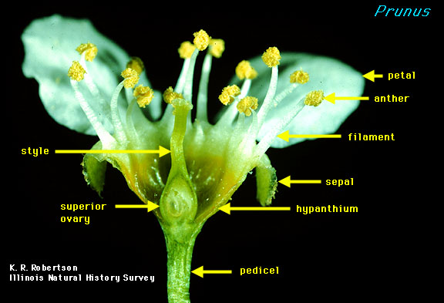
Prunus
Floral Formula:
* K5 C5 A∞ G1

Slide 42
Material:
Class Magnoliopsida,
Subclasses Rosidea
Order Rosales
Family Rosaceae (rose family)
Subfamily Maloideae (apple subfamily), representatives:
Malus domestica
Objective:
To investigate the structural features of flowers of Malus domestica.
Tasks of work
Malus domestica: consider and draw longitudinal section of flower, note hypanthium, arrangement of sepals, petals, stamens.
Draw a pistil. Write a floral formula.

Slide 43
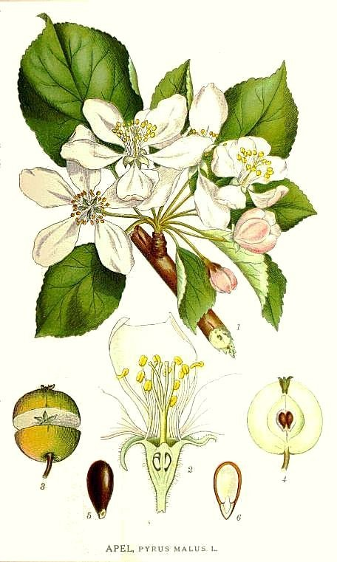
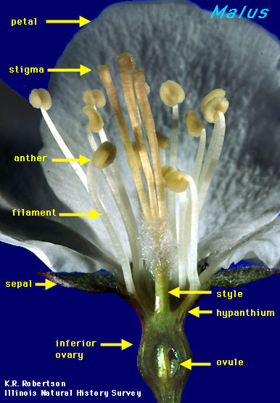
Malus
Floral Formula:
* K5 C5 A∞ G(5)

Slide 44
Material:
Class Magnoliopsida,
Subclasses Rosidea
Order Fabales
Family Leguminosae or Fabaceae (legume family), representatives:
Robinia pseudoacacia L. (black locust, black locust tree, false acacia).
Objective: To investigate the structural features of flowers of Robinia pseudoacacia L.
Tasks of work:
Draw a side view of a flower, unwrapped calyx, all petals of the corolla, note a banner, wing and keel from two fused petals, androecium with stamens (9+1), floral formula.

Slide 45
Characteristics of the Family Fabaceae:
Trees, shrubs or herbs
Plants frequently form a symbiotic relationship with nitrogen-fixing bacteria and form visible nodules on its roots
Leaves are alternately arranged and often compound (pinnately- or palmately-compound, or trifoliate).
Leaflet margins are usually smooth.
Flowers bisexual (having both stamens and a pistil) with radial or bilateral symmetry.
Sepals 5, fused
Petals 5, all similar or differentiated
Stamens many or reduced to 10. If 10 stamens, they may be diadelphous (9 fused and 1 free), Pistil of 1 carpel. Ovary is superior.
Fruit is a legume or loment.

Slide 46
Floral formula:
↑K(5)C1,2,2 A1,(4+5)G1

Slide 47
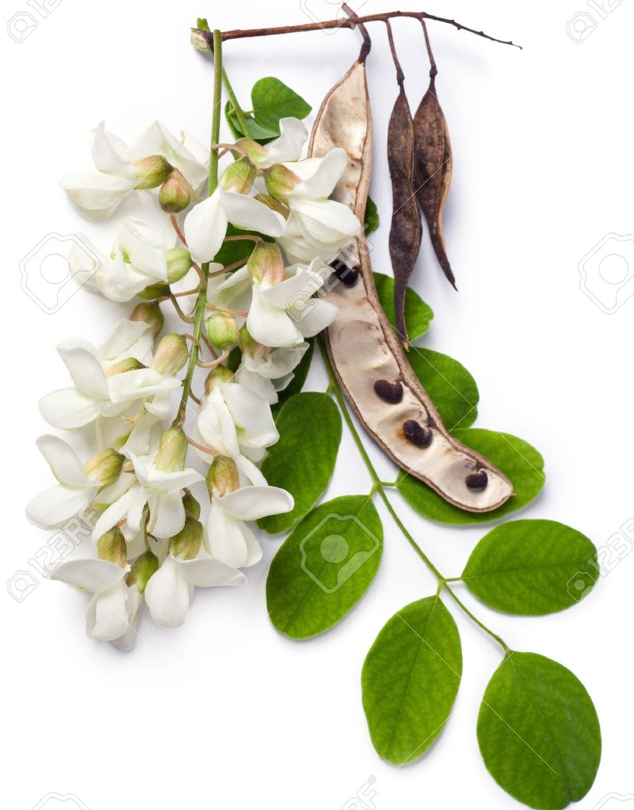
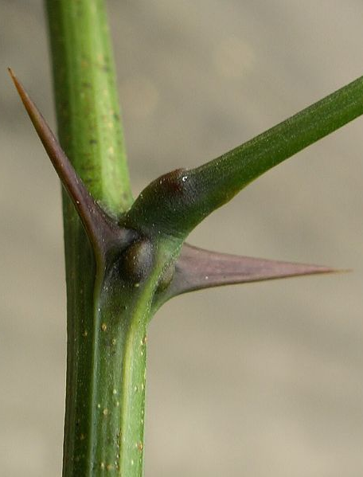
Robinia pseudoacacia
Two broad spines are present at the base of some leaves.

Slide 48
Material:
Division Magnoliophyta
Class Magnoliopsida
Subclass Asteridae
Order Asterales
Family Asteraceae (Compositae) - Aster or Sunflower Family
Subfamily Tubuliflorae
Helianthus annuus (Sunflower)
Objective: To investigate the structural features of flowers of Helianthus annuus.
Tasks of work
Helianthus annuus: consider and draw the appearance of plant, longitudinal section of a flower, denote receptacle, involucral bracts, arrangement of florets.
Draw longitudinal section of a disk tubular florets, denote pappus, corolla, stamens, inferior ovary, style and stigma.

Slide 49
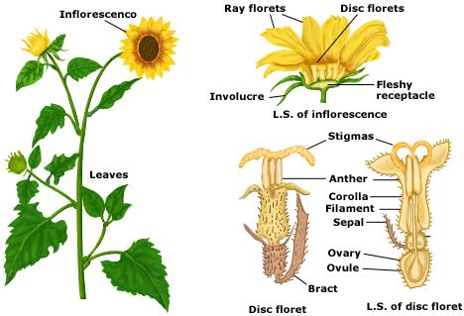
Helianthus annuus

Slide 50
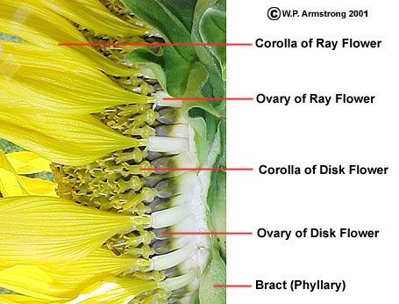
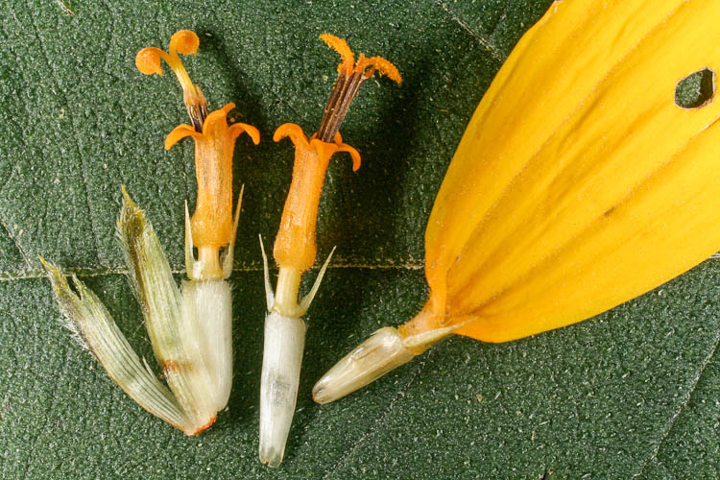
Helianthus annuus

Slide 51
Material:
Division Magnoliophyta
Class Magnoliopsida
Subclass Asteridae
Order Asterales
Family Asteraceae (Compositae) - Aster or Sunflower Family
Subfamily Liguliflorae
Genus Taraxacum, Taraxacum officinale
(Dandelion)
Objective: To investigate the structural features of flowers of Taraxacum officinale. Write classification on Latin.
Tasks of work
Taraxacum officinale: consider and draw the appearance of plant, longitudinal section of a flower, denote receptacle, involucral bracts, arrangement of florets. Draw a fruit.
Draw general view of a tongue-like ray floret, denote pappus, ligule, stamens, inferior ovary, style and stigma.

Slide 52
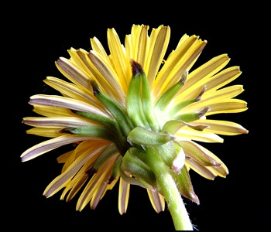
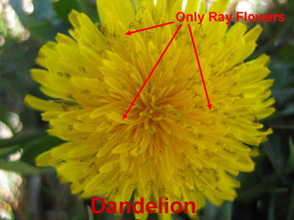
Taraxacum officinale

Slide 53
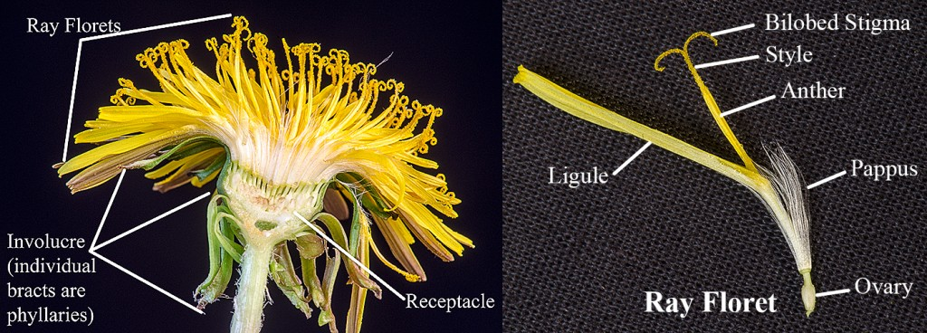
Taraxacum officinale

Slide 54
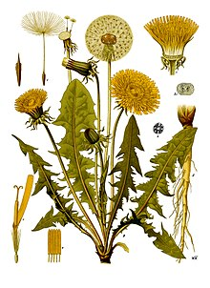
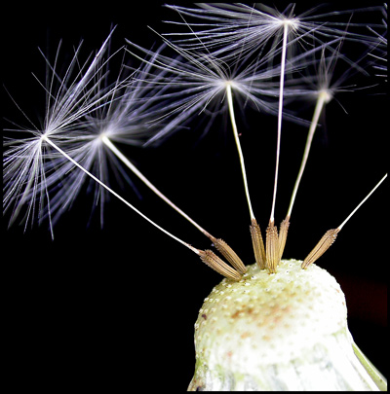
Taraxacum officinale
Fruit: Narrowly obovoid, granular, 3–6 mm long achene, crowned with unbranched hairs on end of long beak.

Slide 55
Material:
Division Magnoliophyta
Class Magnoliopsida
Subclass Asteridae
Order Asterales
Family Asteraceae (Compositae) - Aster or Sunflower Family,
Subfamily Liguliflorae
Genus Cichorium, Cichorium intybus (Chicory)
Objective: To investigate the structural features of flowers of Cichorium intybus.
Tasks of work
Cichorium intybus: consider and draw the appearance of plant, ray floret.

Slide 56
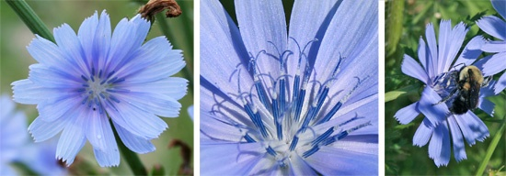
Cichorium intybus
The ligulate homogamous capitula have only ray flowers, meaning all of the individual flowers of the flower head have a strap-shaped ray, which may or may not have teeth at the very tip of the ray

